Slide 1
Using Artificial Intelligence to Optimize Customer Relationship
From transactional data to behavior pattern analysis

Slide 2
7 stage pipeline approach
Determine main customer segments
Refine segmentation by generating microsegments in each main segment
Generate behavior map for all microsegments
Infer behavior vector for each customer microsegment
Generate predictions for recommendations, cross-selling, upselling, etc
Construct churn model and predict potential churn customers
Use predicted potential churn customers and use recommendation model to mitigate churning

Slide 3
Determine main customer segments
Main automated segmentation using multiple variables such as recency, frequency, revenue, margin, revenue per brad, revenue per category
Machine Learning algorithms pick best segmentation strategy and best segment configuration ( “worst customers” to “best customers”)
Whole process is automated and self-explainable (using visual decision trees)
Finally segments can be used for high-level targeting

Slide 4
Refine segmentation by generating microsegments in each main segment
Following main segmentation AI system moves further and micro-clusters each segment (from best sub-segments to worst ones)
Finally we obtain 100 microsegments for each main segment (considering a scale from worst 1% to best 1% of each particular segment)
This refined micro-segmentation allows us to target specific “customer ranges” (such as “best customers from middle segment” or “high revenue low frequency customers from best customers segment”)

Slide 5
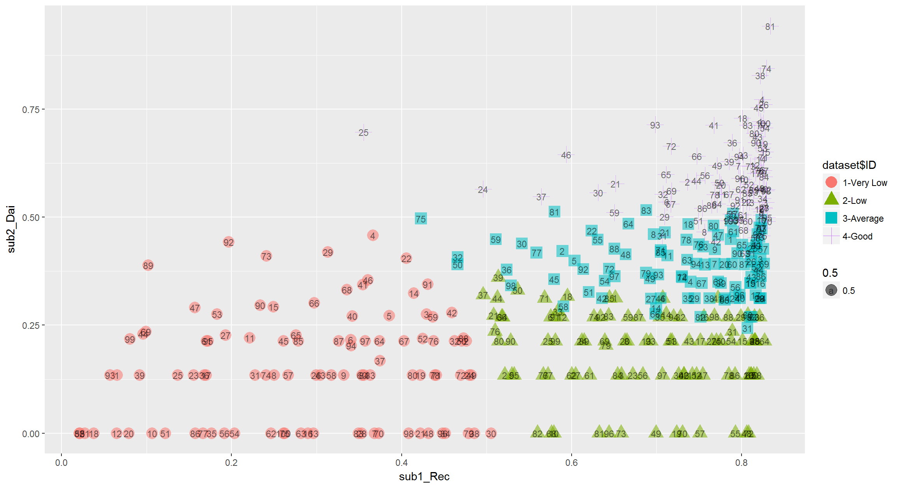
Refine segmentation by generating microsegments in each main segment

Slide 6
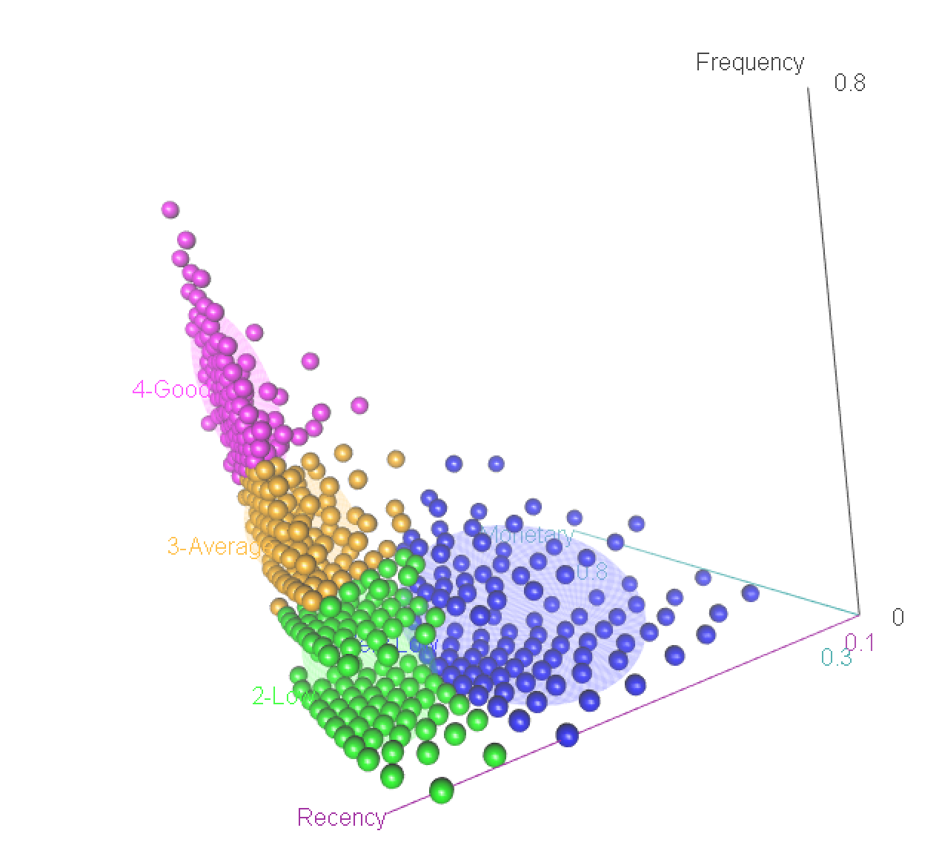
... view it in 3D...

Slide 7
NEXT: Generate behavior map for all microsegments
Next stage gives us a real 2D map of the customer micro-segmentation based on their actual transactional behavior
We can now find groups of micro-segments that behave in a similar pattern
This powerful Machine Learning assisted tool can generate intelligent targets

Slide 8
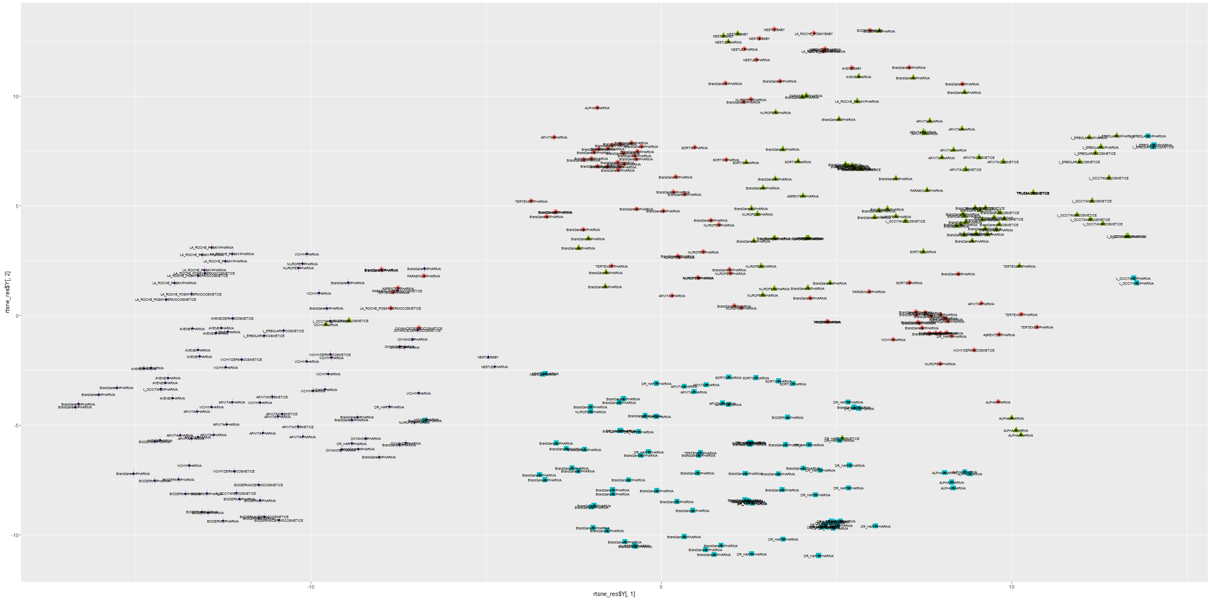

Slide 9
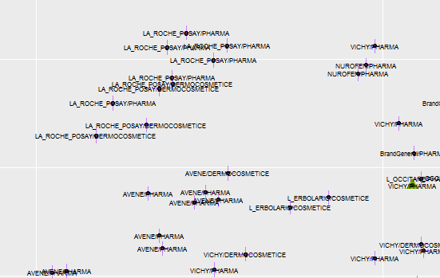
Zooming...

Slide 10
Infer behavior vector for each customer microsegment
Using a advanced recommender system based on implicit feedback data we construct a 900+ variable behavior vector that describes in detail both the micro-clusters and the actual customers.
We can infer now real behavior patterns at microsegment level and at customer level.
Behavior patterns include variables such as “brand x preference” or “skin area Y dermatological needs”

Slide 11
Generate predictions for recommendations, cross-selling, upselling, etc
Based on behavior vector now we can have recommendation for each microsegment and customer regarding any product – previously purchased, unseen or even just lunched on the market
Customer | Product | Previous purchase | Purchase prediction
#13792 | Product A | 0 | 10
#13792 | Product B | 30 | 28
#13792 | Product C | 0 | 41
#13792 | Product D | 15 | 19

Slide 12
Construct churn model and predict potential churn customers
Advanced churn model is automatically and continuously updated based on transactional data
Customers with high churn risk are marked

Slide 13
Use predicted potential churn customers and use recommendation model to mitigate
Our advanced Machine Learning modules microsegment the customers with high churn risk
For each churn microsegment the systems analyzes purchase and recommendations prediction to propose a “churn mitigation campaign”

